Slide 1
Import numpy_cat as np
Scooters Project

Slide 2
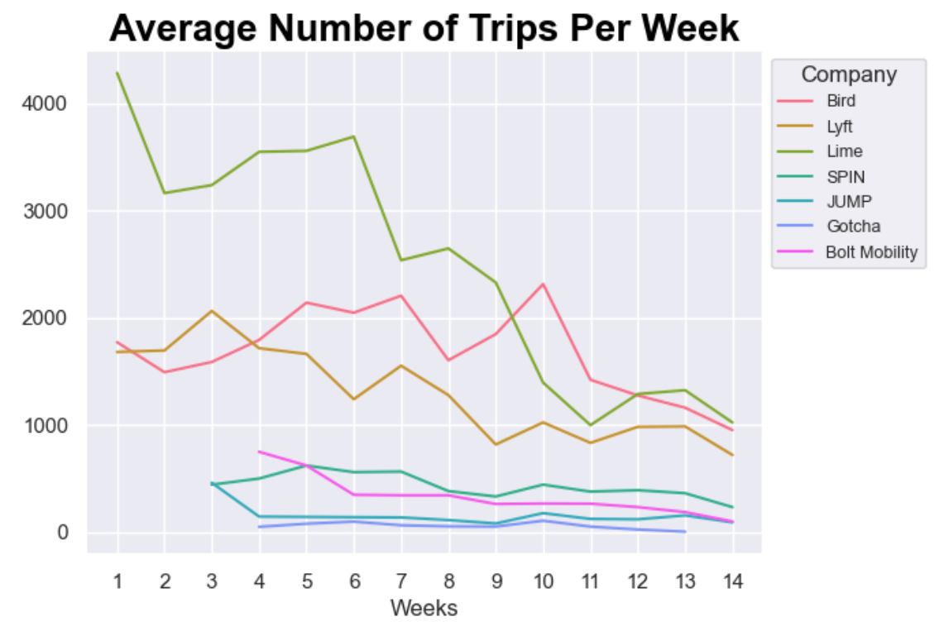
Notes:
Lime, Bird and Lift consistently had more trips per week than the other companies
The general trend for number of trips - as time went on, there were less trips taken (novelty effect)

Slide 3
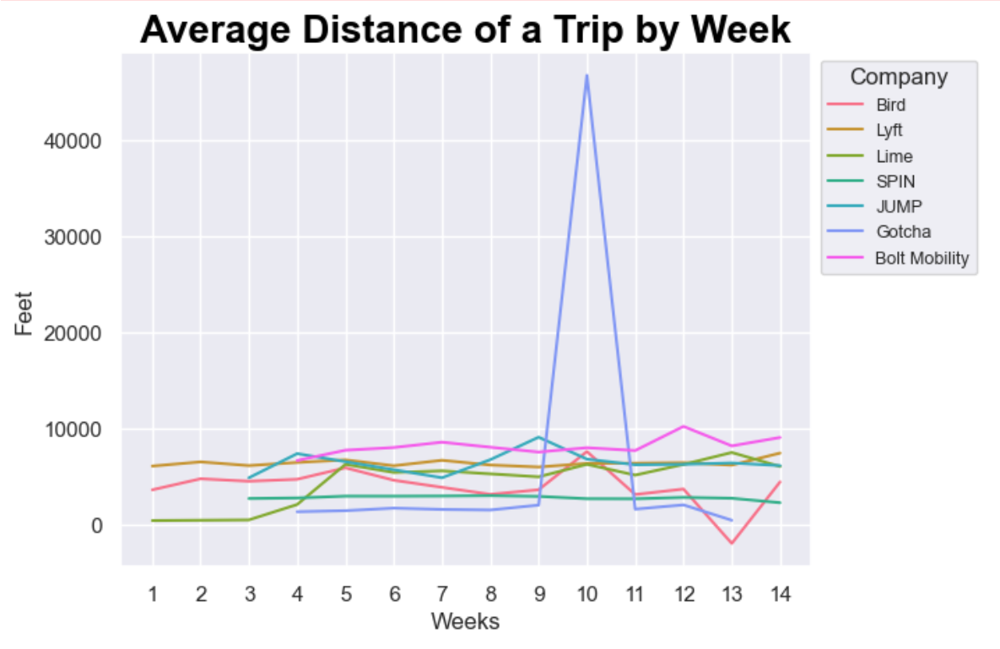
Notes:
Over 9 miles on average for Gotcha for week 10
Could just just bad data
DATA CLEANING THINGS:
Removed trips with negative distance
Removed trips that were logically impossible (10 miles in 2 mins)

Slide 4
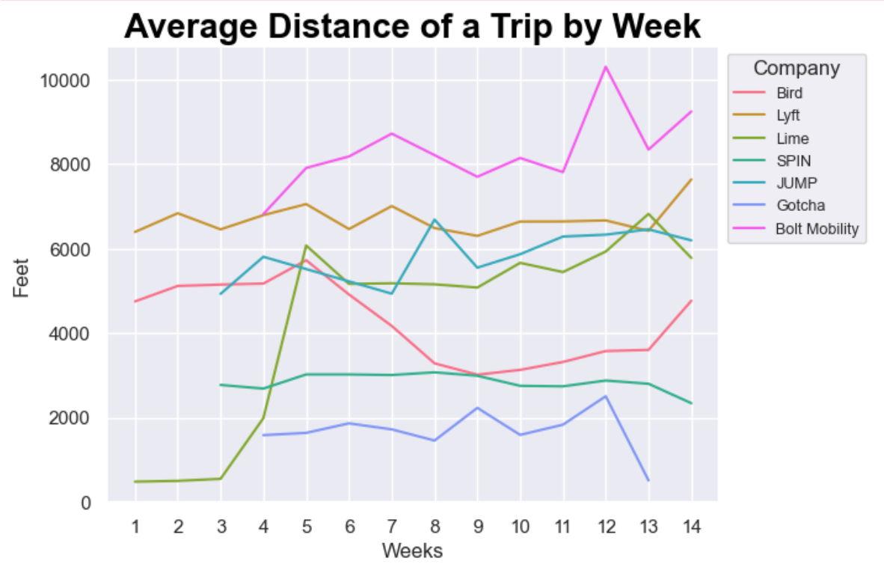
Notes:
For the most part, trips were between 2,000-10,000ft (between .5 and 2 miles)
Gotcha had the shortest trips (most were under a half a mile)
Bolt had the longest trips (between 1-2 miles)

Slide 5
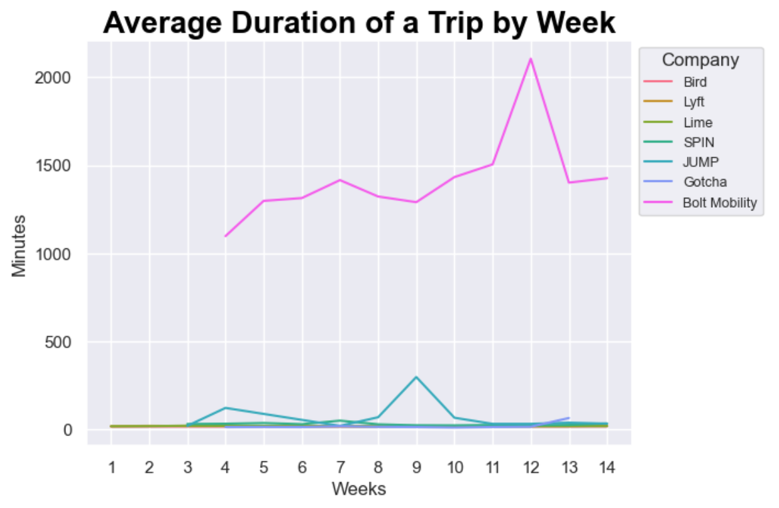
Notes:
Based on the start and stop times, it looks like Bolt submitted their time in seconds and not minutes.
DATA CLEANING THINGS:
Changed bolt from seconds to minutes

Slide 6
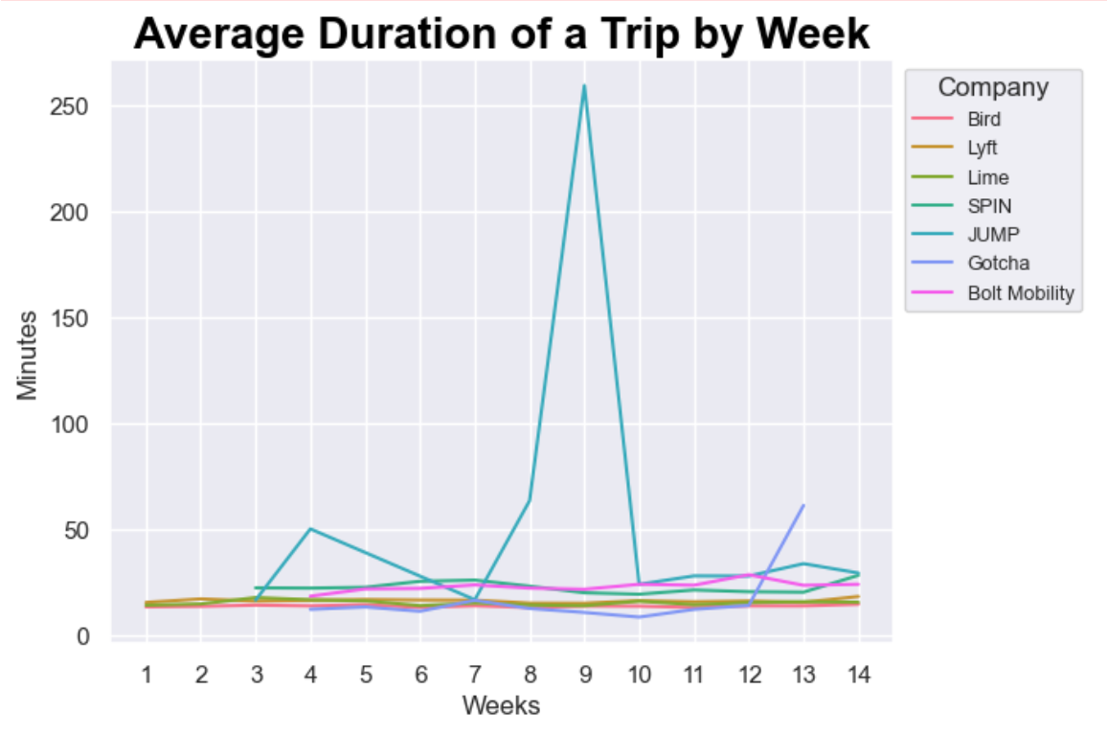
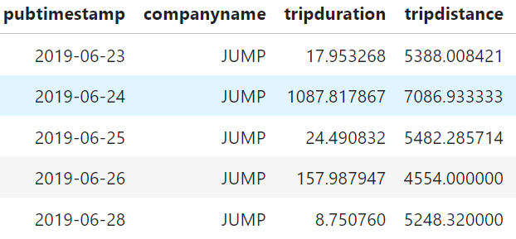
Notes:
Aside from JUMP, duration of a trip is usually between 10-30 min
Bolt and Spin having slightly longer trips than the rest

Slide 7
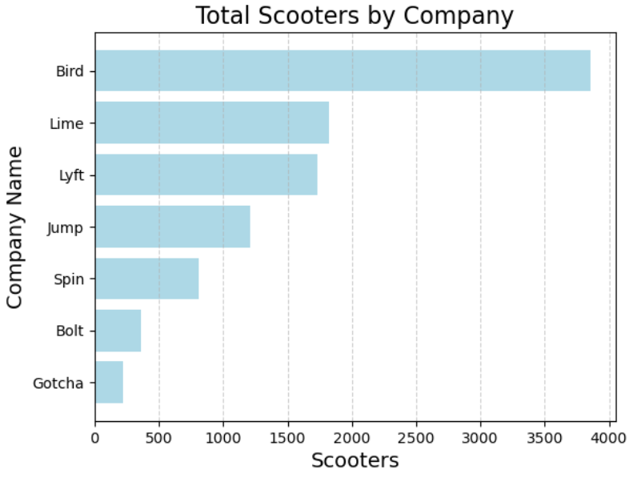
Notes:
Bird had the most scooters with almost 4,000
Gotcha had the least amount of scooters (a little more than 200)

Slide 8
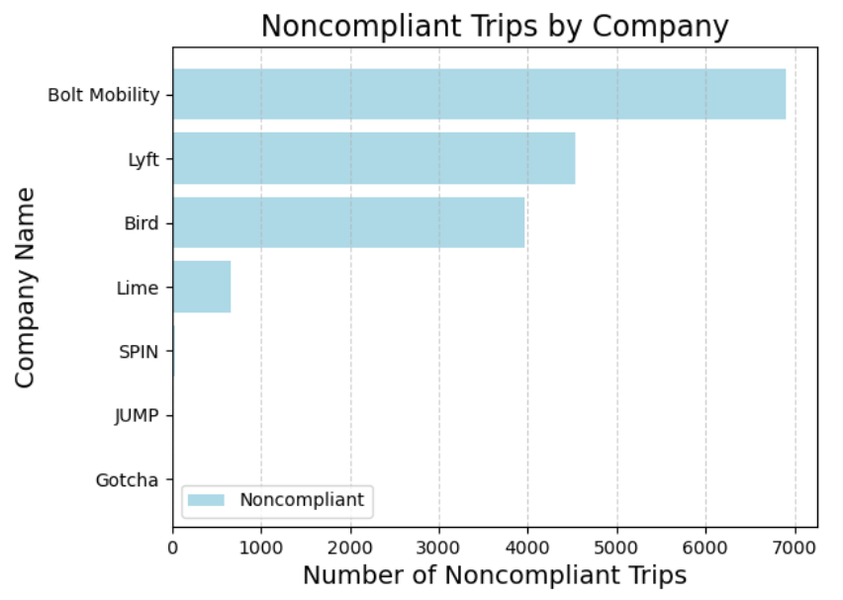
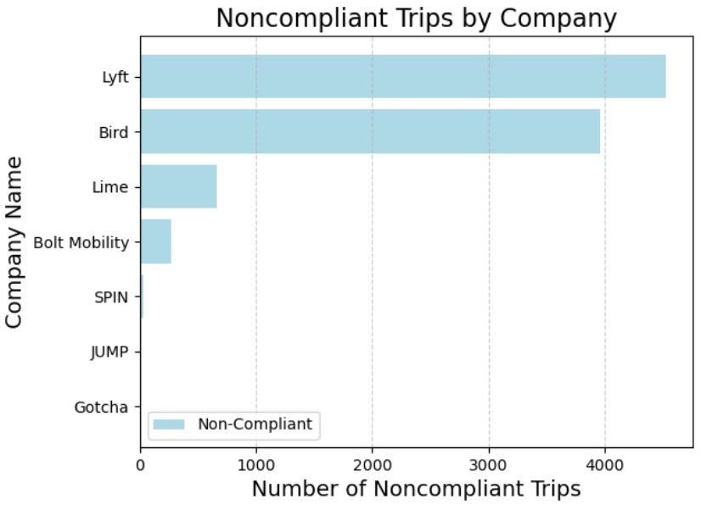
Compliance Snapshot: Scooter Operators' Adherence to BL2018-1202
**Before Cleaning Bolt Mobility
**After Cleaning Bolt Mobility
Note: Gotcha was the only company with 100% Compliance.
Notes:
Elisia
565,522 Total Trips, 549k were compliant and 16k were non compliant -
Compliance is defined as trips that last longer than 1 minute, but less than 24 hours.
Bolt Mobility
Average trip duration: 1,408 minutes (23.5 hours)
3,047 trips were above 24 hours
Upon examining Bolt's data, we noticed that the trip duration was recorded in seconds instead of minutes. After cleaning Bolt's data, we generated the correct bar chart. Following the cleaning process, the number of noncompliant trips for Bolt decreased from just under 7,000 to just under 300.
Lyft
4,333 trips were under 1 minute
8 trips were negative durations
Bird
3,963 noncompliant trips were exactly 0 seconds
LIME
661 noncompliant trips were exactly 0 seconds
SPIN
28 trips were above 24 hours

Slide 9
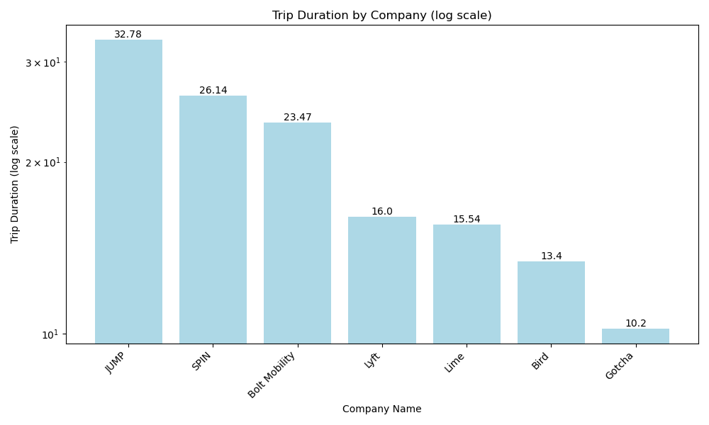
Usage: Avg. Trip Duration by Company
Notes:
William - Overall average 69.8 minutes
Note: Bolt Mobility seems to measure their time in seconds as compared to minutes (Technically non-compliant as the requirements were in minutes.)

Slide 10
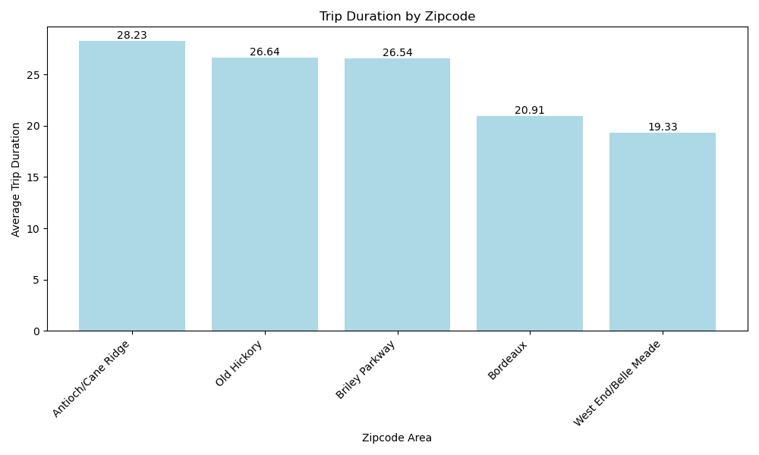
Usage: Avg. Trip Duration by Zip Code
Notes:
William - Overall average 69.8 minutes

Slide 11
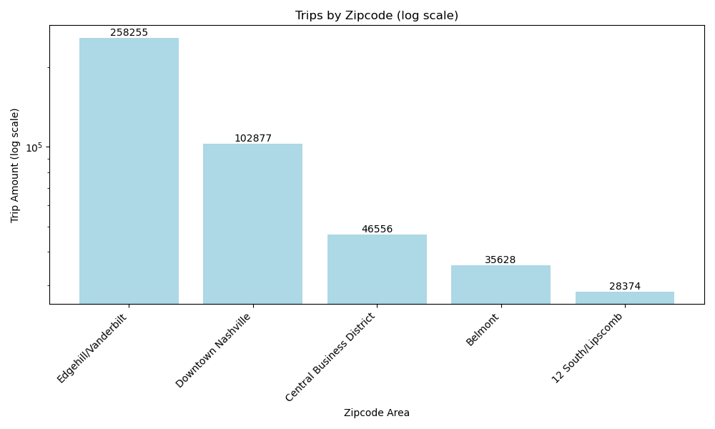
Usage: Trip Counts by Zip Code
Notes:
William - 37203 is near Vandy’s Campus, so college students are a big part

Slide 12
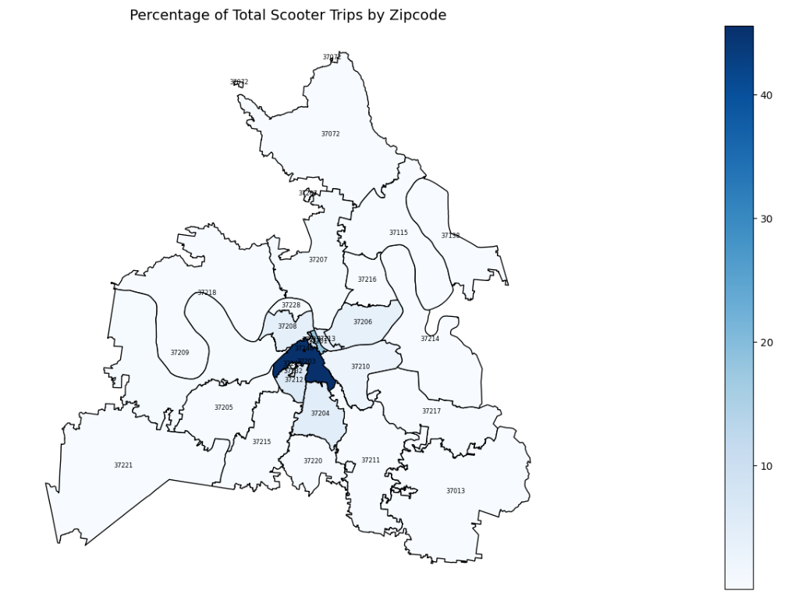
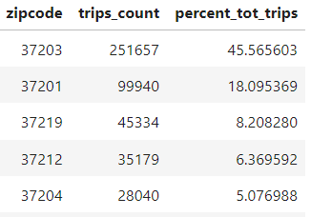
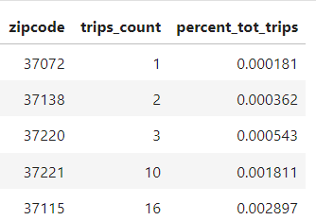
Usage: Maps
Top 5 by Percentage of Total Scooter Trips
Bottom 5 by Percentage of Total Scooter Trips
Notes:
Jai
Note: Worth making this text a bit easier to read - Wm

Slide 13
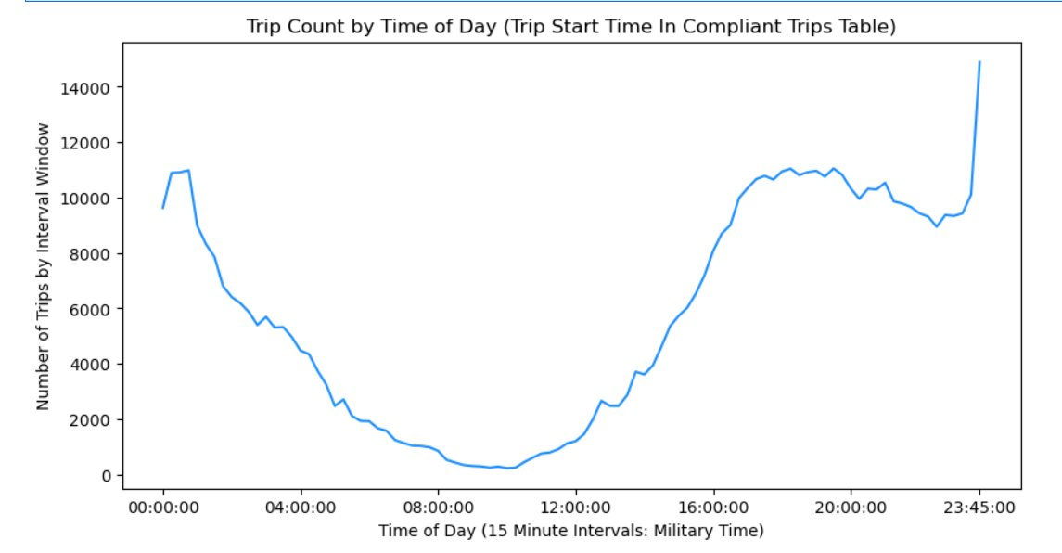
Usage: Time of Day
Time of day peak usage is between 5p and 1am.
Notes:
Brandy Highest usage between 11:30PM, lowest between 5AM and noon
Usage patterns:

Slide 14
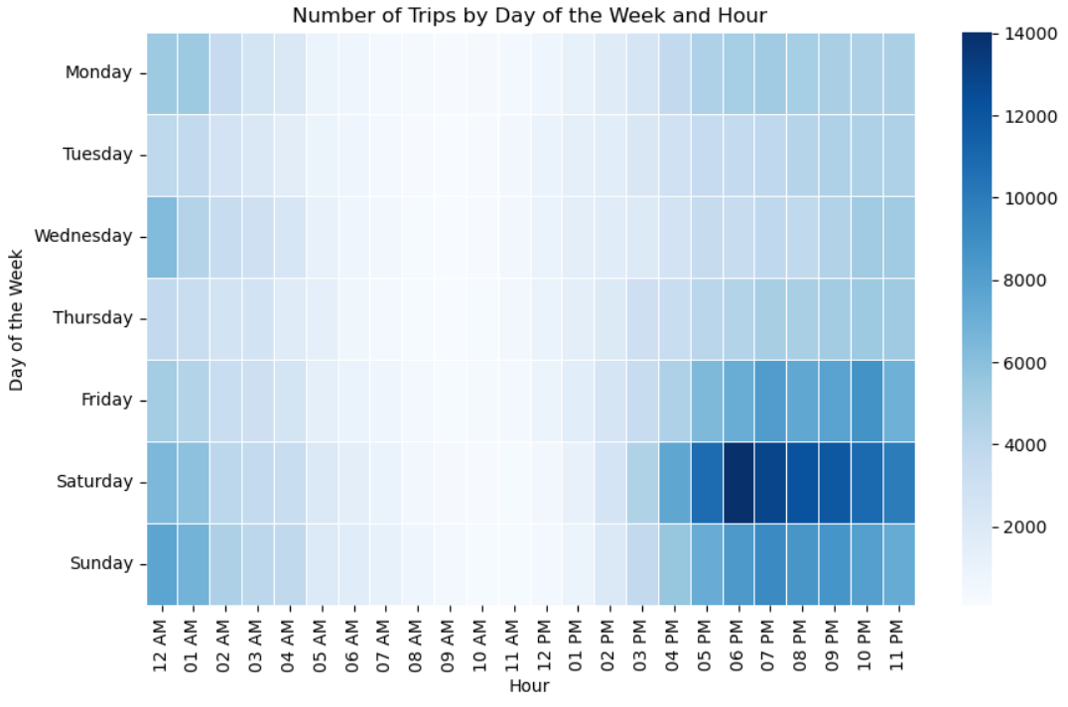
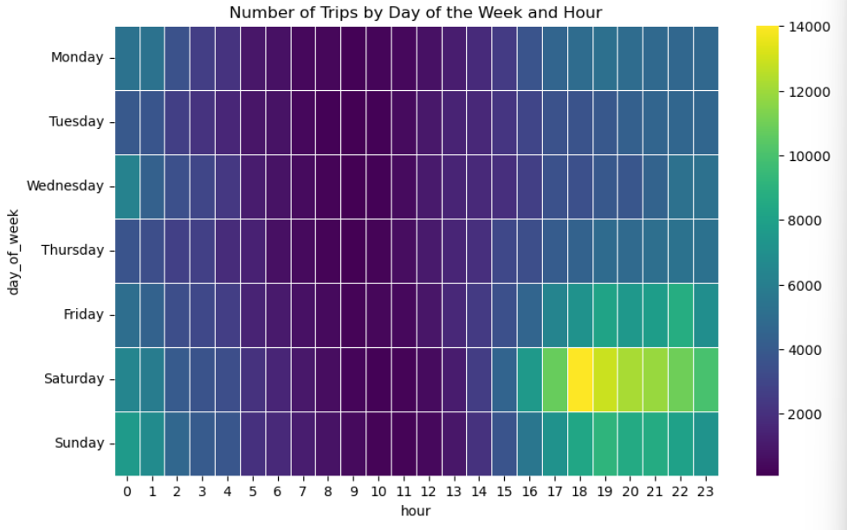
Usage: Trip Count by Day of Week and Hour
Notes:
Brandy

Slide 15
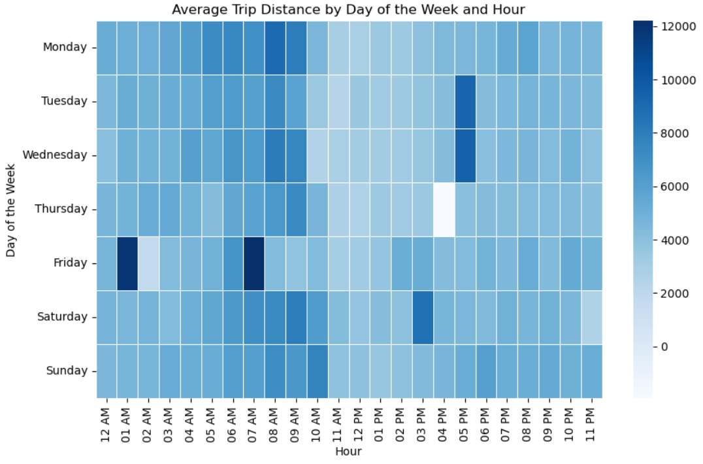
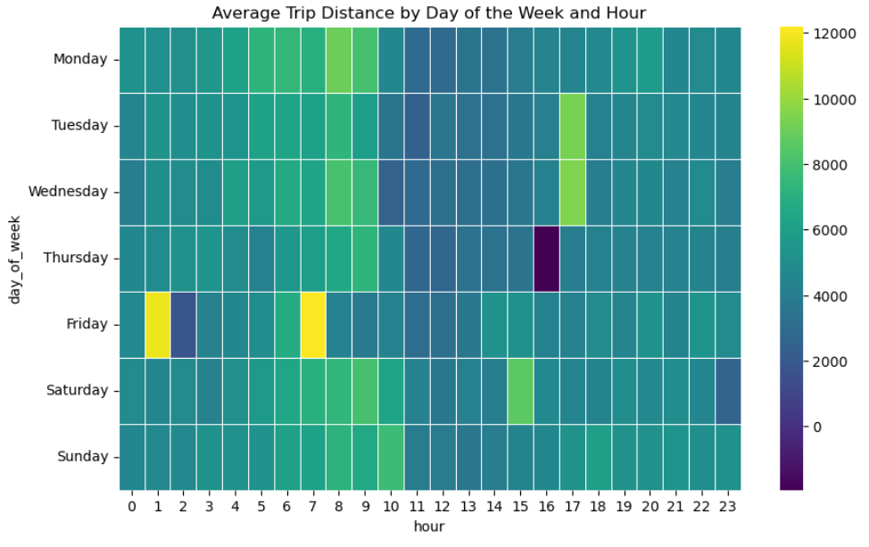
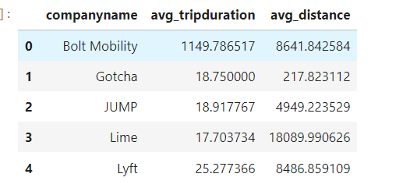
Usage: Average Distance by Day of Week and Time
Lift had negative distances recorded
Notes:
Brandy try to explain the below 0 and the higher distances
Lift had negative distance

Slide 16
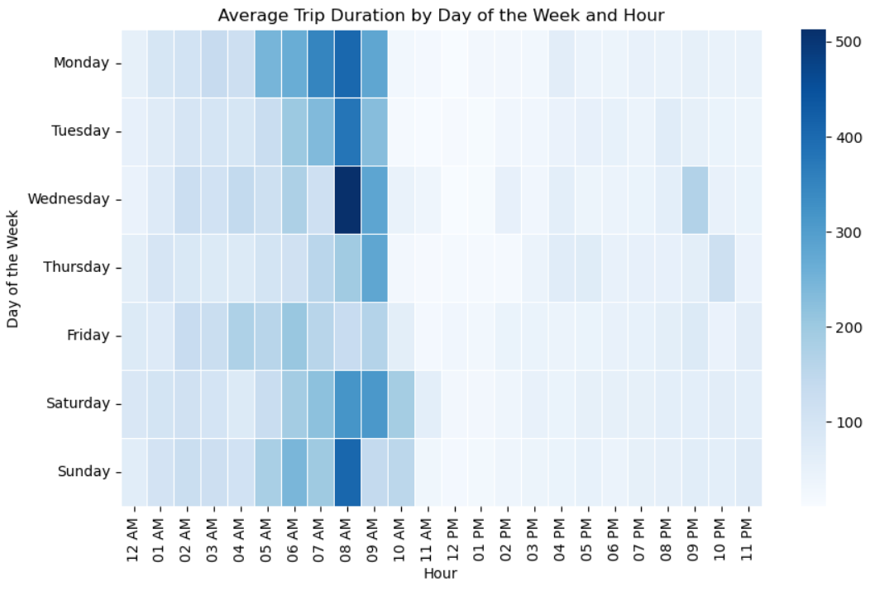
Usage: Day of Week/Hourly Trip Duration Heatmap
Notes:
Brandy - They were usd the longest on Wednesday morning at 8

Slide 17
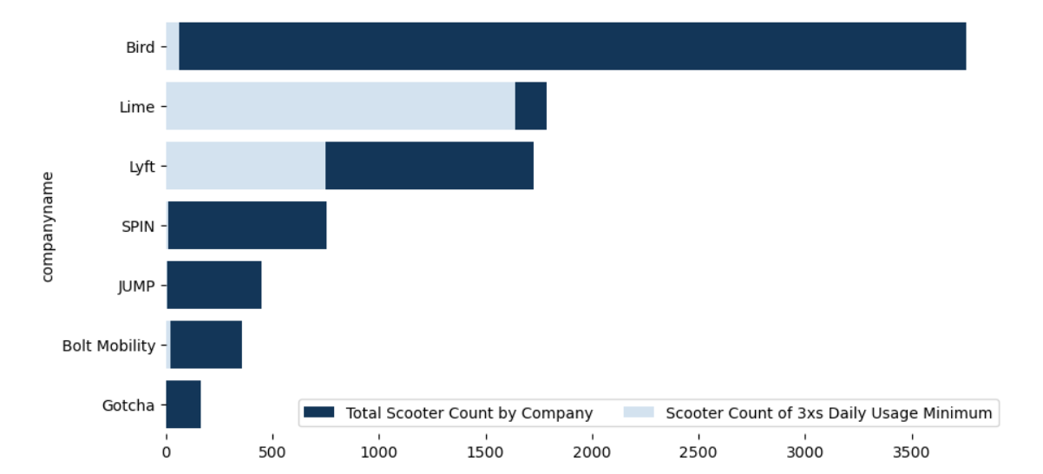
Scooter Number Recommendation
Compliance is defined as trips that last longer than 1 minute, but less than 24 hours. While cleaning the data noticed the values in the “Trip Duration” column were inconsistent. In SQL we subtracted the “Start Time” column from the “End Time” column to calculate “Elapsed Time”.
**Scooters refers to “Sumdtype” powered from the Scooters Table.
Trips in Compliance
552.2k
Scooters Used 3xs Daily
2.4k
Scooter count should not exceed 2500, and scooters should be available Fri-Sun by 5pm.
Notes:
Jai

